Slide 1
SOLUTIONS
Solutions are homogeneous mixtures of two or more than two
Components.
The
component that is present in the largest quantity is known as solvent.
One or
more components present in the solution other than solvent are called
solutes.

Slide 2
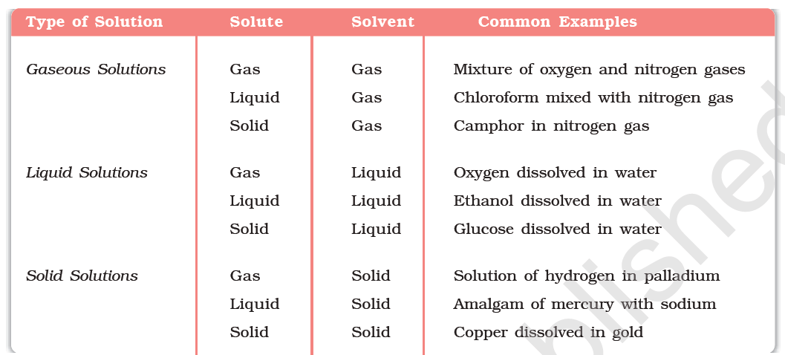
Types of Solutions

Slide 3
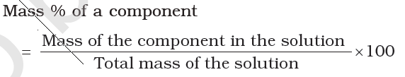
Expressing Concentration of Solutions
Mass percentage (w/w):The mass percentage of a component of a solution is defined as:

Slide 4
Volume percentage (V/V): The volume percentage is defined as:

Slide 5
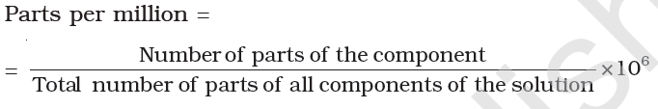
Parts per million: When a solute is present in trace quantities, it is convenient to express concentration in parts per million (ppm) and is defined as:

Slide 6
Mole Fraction:
Molarity:
Molality:
Molality is better to express the concentration of the solution as compared to molarity. Because molarity depends upon volume and volume is temperature dependent. Thus molarity changes with change in temperature but molality not because mass does not vary with temp.

Slide 7
Solubility
Solubility of a substance is maximum amount that can be dissolved in a specified amount of solvent at a specified temperature.
Solubility of a Solid in a Liquid: a solute dissolves in a solvent if the intermolecular interactions are similar in the two or we may say like dissolves like.
solution in which no more solute can be dissolved at the same temperature and pressure is called a saturated solution.

Slide 8
Effect of temperature on solubility: Solubility increases with increase in temperature.
Effect of pressure: Pressure does not have any significant effect on solubility of solids in liquids. It is so because solids and liquids are highly incompressible and practically remain unaffected by changes in pressure.

Slide 9
Solubility of a gas in liquids:Many gases dissolve in water. Solubility of gases in liquids is greatly affected by pressure and temperature. The solubility of gases increase with increase of pressure.
Henry’s law: the solubility of a gas in a liquid
is directly proportional to the pressure of the gas.
Dalton, also concluded independently that the solubility of a gas in a liquid solution is a function of partial pressure of the gas.

Slide 10
It can be concluded that the mole fraction of
gas in the solution is proportional to the partial pressure of the gas over the solution. Thus Henry’s law can be defined as in terms of mole fraction as, “the partial pressure of the gas in vapour phase (p) is proportional to the mole fraction of the gas (x) in the solution”
ie p=K_{H}x
where K_{H} is Henry’s constant and x is mol fraction.

Slide 11
K_{H} is a function of the nature of the gas. higher the value of KH at a given pressure, the lower is the solubility of the gas in the liquid.
K_{H} values for both N₂ and O₂ increase with increase of temperature indicating that the solubility of gases increases with decrease of temperature. It is due to this reason that
aquatic species are more comfortable in cold waters rather than in warm waters.

Slide 12
Applications of Henry’s law
Scuba divers must cope with high concentrations of dissolved gases while breathing air at high pressure underwater. Increased pressure increases the solubility of atmospheric gases in blood. When the divers come towards surface, the pressure gradually decreases. This releases the dissolved gases and leads to the formation of bubbles of nitrogen in the blood. This blocks capillaries and creates a medical condition known as bends, which are painful and dangerous to life.

Slide 13
To increase the solubility of CO2 in soft drinks and soda water, the bottle is sealed under high pressure.
At high altitudes the partial pressure of oxygen is less than that at the ground level. This leads to low concentrations of oxygen in the blood and tissues of people living at high altitudes or climbers. Low blood oxygen causes climbers to become weak and unable to think clearly, symptoms of a condition known as anoxia.

Slide 14
Effect of Temperature: Solubility of gases in liquids decreases with rise in temperature. As dissolution is an exothermic process, the solubility should decrease with increase of temperature.

Slide 15
Vapour Pressure of Liquid Solutions
solutions may contain one or more volatile components. Generally, the liquid solvent is volatile. The solute may or may not be volatile.
Vapour pressure of liquid liquid solutions:
Raoult’s law: It states that for a solution of volatile liquids, the partial vapour pressure of each component of the solution is directly proportional to its mole fraction present in solution.

Slide 16
ie for first liquid p₁ ∝ x₁
p₁ ₌ p₁⁰ x₁
And for second liquid
p₂ ∝ x₂
p₂ ₌ p₂⁰ x₂
Accordind to Dalton’s law,
P = p₁ + p₂ ₌ p₁⁰ x₁ + p₂⁰ x₂
= p₁⁰ (1-x₂) + p₂⁰ x₂
= p₁⁰+ (p₂⁰ - p₁⁰) x₂

Slide 17
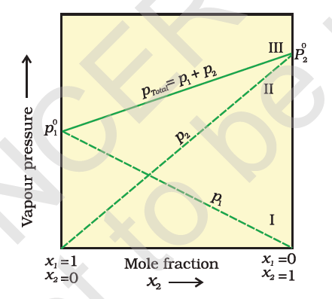
A plot of p₁ or p₂ versus the mole fractions x₁ and x₂ for a solution gives a linear plot as shown in Fig.

Slide 18
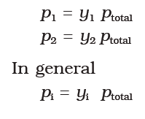
If y₁ and y₂ are the mole fractions of the components 1 and 2 respectively in the vapour phase then, using Dalton’s law of partial pressures:

Slide 19


Raoult’s Law as a special case of Henry’s Law
According to Raoult’s law,
According to Henry’s law,
It can be seen that the partial pressure of the volatile component or gas is directly proportional to its mole fraction in solution. Only the proportionality constant K_{H} differs from p₁⁰. Thus, Raoult’s law becomes a special case of Henry’s law in which K_{H} becomes equal to p₁⁰.

Slide 20
Vapour Pressure of Solutions of Solids in Liquids
Vapour pressure of a solution containing nonvolatile solid is lower than the vapour pressure of the pure solvent. In the solution, the surface has both solute and solvent molecules; thereby the fraction of the surface covered by the solvent molecules gets reduced. Consequently, the number of solvent molecules escaping from the surface is correspondingly reduced, thus, the vapour pressure is also reduced.

Slide 21
Thus Raoult’s law in its general form can be stated as, for any solution the partial vapour pressure of each volatile component in the solution is directly proportional to its mole fraction.
In such cases P = p₁⁰ x₁

Slide 22
Ideal Solutions
The solutions which obey Raoult’s law over the entire range of concentration are known as ideal solutions.
Also Δ_{mix}H=0 and Δ_{mix}V=0
If the intermolecular attractive forces between the A-A and B-B are nearly equal to those between A-B, this leads to the formation of ideal solution.

Slide 23
Non ideal solutions
When a solution does not obey Raoult’s law over the entire range of concentration, then it is called non-ideal solution.
The vapour pressure of such a solution is either higher or lower than that predicted by Raoult’s law. If it is higher, the solution exhibits positive deviation and if it is lower, it exhibits negative deviation from Raoult’s law.

Slide 24
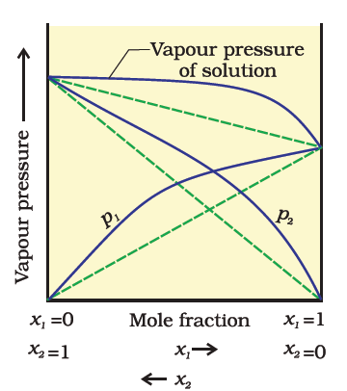
In case of positive deviation from Raoult’s law, A-B interactions are weaker than those between A-A or B-B.
This will increase the vapour pressure and result in positive deviation. Mixtures of ethanol and acetone behave in this manner.

Slide 25
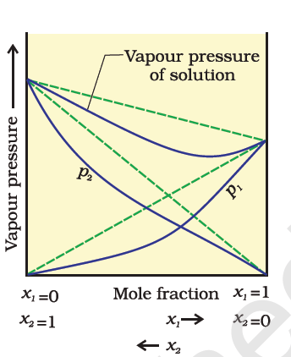
In case of negative deviations from Raoult’s law, the intermolecular attractive forces between A-A and B-B are weaker than those between A-B and leads to decrease in vapour pressure resulting in negative deviations. Example of this type is a mixtures are of phenol and aniline and a mixture of chloroform
and acetone.

Slide 26
azeotropes
The binary mixtures having the same composition in liquid and vapour phase and boil at a constant temperature.
There are two types of azeotropes called minimum boiling azeotrope and maximum boiling azeotrope.
The solutions which show a large positive deviation from Raoult’s law form minimum boiling azeotrope at a specific composition.
The solutions that show large negative deviation from Raoult’s law form maximum boiling azeotrope at a specific composition.

Slide 27
Colligative Properties and Determination of Molar Mass
properties which depend on the number of solute particles and not on the nature of solute are called Colligative properties.

Slide 28




Relative Lowering of Vapour
The vapour pressure of a solvent in solution is less than that of the pure solvent.
We know

Slide 29

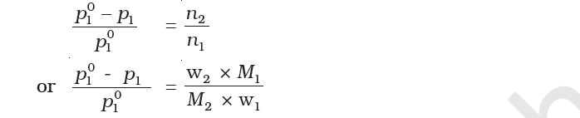
Calculation of molar mass
We know
For dilute solutions n₂ < < n₁,hence neglecting n₂ in the denominator we have
Here w₁ and w₂ are the masses and M₁ and M₂ are the molar masses of the solvent and solute respectively.

Slide 30
Elevation of boiling point
The temperature at which its vapour pressure becomes equal to the atmospheric pressure is called as Boiling point.
the boiling point of a solution is always higher than that of the boiling point of the pure solvent.
The elevation of boiling point also depends on the number of solute molecules rather than their nature. Therefor it is a colligative property.

Slide 31

Let T_{b}⁰ be the boiling point of pure solvent and T_{b} be the boiling point of solution. The increase in the boiling point ΔT_{b} = Tb − Tb⁰ is known as elevation of boiling point.
Experiments have shown that for dilute solutions the elevation of boiling point (ΔTb) is directly proportional to the mola concentration of the solute in a solution. Thus
K_{b} is called Boiling Point Elevation Constant or Molal Elevation Constant (Ebullioscopic
Constant). The unit of K_{b} is K kg mol⁻¹.

Slide 32
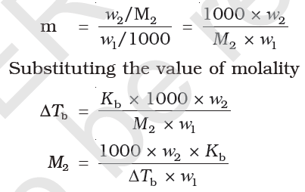
Calculation of molar mass from elevationin boiling point: If w₂ gram of solute of molar mass M₂ is dissolved in w₁ gram of solvent, then molality, m of the solution is given by the expression.

Slide 33
Depression of Freezing Point
The freezing point of a substance may be defined as the temperature at which the vapour pressure of the substance in its liquid phase is equal to its vapour pressure in the solid phase.
According to Raoult’s law when a nonvolatile solid is added to the solvent its vapour pressure decreases and now it would become equal to that of solid solvent at lower temperature. Thus, the freezing point of the solvent decreases.

Slide 34
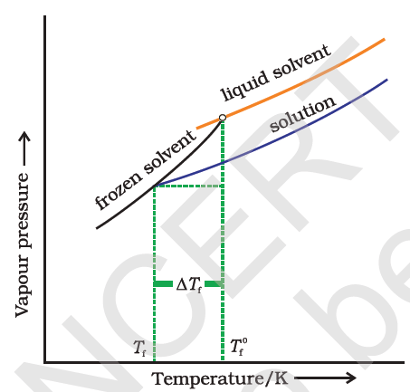
T_{f} ⁰ be the freezing point of pure solvent and T_{f} be its freezing pointof solution. The decrease in freezing point is given as
ΔT_{f} = T_{f} ⁰ − T_{f}
Since depression in
Freezing point is
Proportional to
Molarity, it is a colligative
Property.

Slide 35

Mathematically
K_{f} which depends on the nature of the solvent is known as Freezing Point Depression Constant or Molal Depression Constant or Cryoscopic Constant. The unit of K_{f} is K kgmol⁻¹.

Slide 36
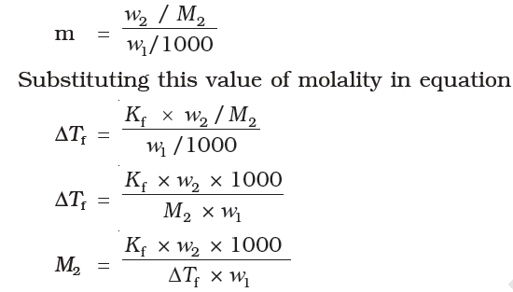
Calculation of molar mass of solute
Since

Slide 37
Osmosis and Osmotic Pressure
The process of movement of solvent molecules from pure solvent to the solution through semipermeable membrane is called osmosis.
The excess pressure that just stops the flow of solvent from solvent to solution side is called osmotic pressure of the solution.
Osmotic pressure is a colligative property as it depends on the number of solute molecules and not on their identity.

Slide 38
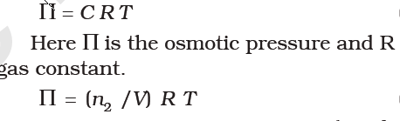
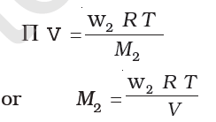
it has been found experimentally that osmotic pressure is proportional to the molarity, C of the solution at a given temperature T. Thus:
If W₂ is the mass of the solute and M₂ molar mass, then n₂ = w₂ / M₂ and we can write
Π

Slide 39
Advantages of osmotic pressure
The osmotic pressure method has the advantage over other methods as pressure measurement is around the room temperature and the molarity of the solution is used instead of molality. As compared to other colligative properties, its magnitude is large even for very dilute solutions.
The technique of osmotic pressure for determination of molar mass of solutes is particularly useful for biomolecules as they are generally not stable at higher temperatures and polymers have poor solubility.

Slide 40
Two solutions having same osmotic pressure at a given temperature are called isotonic solutions.
If one solution have high osmotic pressure as compared to other then it is called as Hypertonic and the one with low value of osmotic pressure is called as Hypotonic solution.
Reverse Osmosis: The phenomenon of flow of solvent from solution to solvent side after applying pressure greater than osmotic pressure on solution side is called as reverse osmosis.
Reverse osmosis is used in desalination of sea
water.

Slide 41
Abnormal molar masses
when there is dissociation of solute into ions, the experimentally determined molar mass is always lower than the true value.
Some of the molecules exist in the form of dimers or trimer. In such cases molar mass calculated will be twice the expected value.
Such a molar mass that is either lower or higher than the expected or normal value is called as abnormal molar mass.

Slide 42
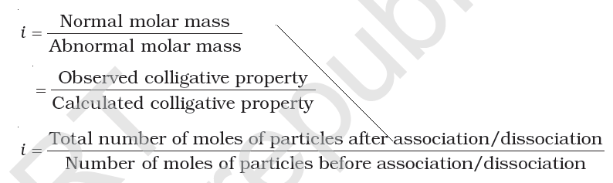
Van’t Hoff factor: it is defined as:

Slide 43
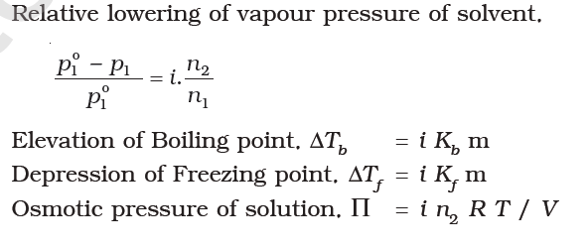
In case of association, value of i is less than unity while for dissociation it is greater than unity.
Inclusion of van’t Hoff factor modifies the equations for colligative properties as follows:

